Slide 1

Real World Connections
Summer 2024 Track

Slide 2
Introduction to Python via
Game development

Slide 3
Agenda
Web Privacy – Karem Khalifa
Pause – Diego Correa
Blackjack Game – Alejandro Mejia
Shrinking Borders – Sonja Sosa
Shrinking Paddle Size – Jacob Sanchez
Double Speed Powerup – Vanessa Mejia
Redirection Powerup – Dylan Flores
Extra Balls – Caleb Mylius
3

Slide 4
Web Privacy
Karem Khalifa

Slide 5
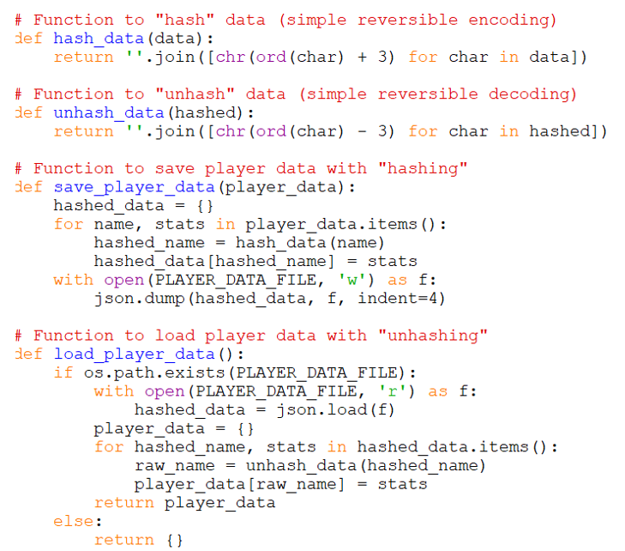
Web Privacy
Notes:
My name is Karem. This is our code for our web privacy portion of our project, I created a function that takes usernames and their stats like wins and win ratio and hashes them to protect user data. I learned that these steps are important for web privacy and protecting user data.

Slide 6
Web Privacy Principles
Data Minimization
Data Security
Data Integrity
Transparency
Accountability
Notes:
The Web Privacy Principles that were addressed by hashing are:
Data Minimization – By transforming player names into hashed values, the system ensures that actual names are never directly exposed or stored in the storage medium. This minimizes the risk with data breaches and limits exposure of personal data to reduce risks.
Data Security – Hashing functions like Security Hash Algorithm-256 ensures that even if data is intercepted, it isn’t easily readable without decoding.
Data Integrity – Protecting data when intercepted is also a form of data integrity as it prevents unauthorized tampering of the data.
Transparency – Hashing practices in a game application can be accompanied by privacy policies that explain how a player’s data is protected and stored.
Accountability – By implementing hashing, we as developers demonstrate a commitment to data protection. In addition, we would implement things like data audits, updates to our security practices, and compliance with relevant data protection regulations like the GPDR.
The next thing I’d like to learn is more advanced methods to protect user data.

Slide 7
Shrinking Borders
Sonja Sosa

Slide 8

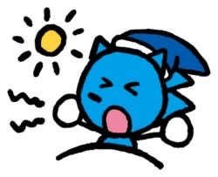
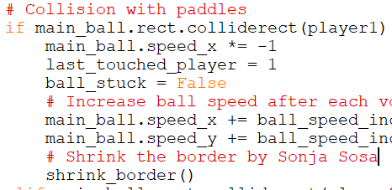

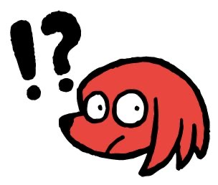
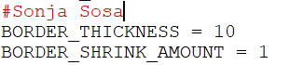
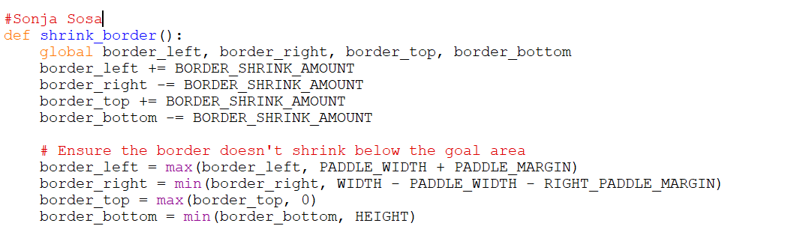


This feature is where the border shrinks by every volley of the ball, making the game go faster and making gameplay more intense and requires more focus and concentration, since the play area gets smaller quickly.
BORDER_THICKNESS equaling 10 means the border is thick by 10 pixels. BORDER_SHRINK_AMOUNT equaling 1 means that for every volley of the ball, the border will decrease in size by 1 pixel.
The shrink_border() function is only active whenever the main ball comes in contact with player 1 or player 2’s paddle.
sonja sosa
who I am
age: 13
school: union hill middle school
hobbies: drawing, listening to music, playing games
what is this about? what’s next?
this is about my contribution to the game the python track has created. I am looking forward to seeing a more creative and somewhat harder game for the next session of RWC, so hopefully that’s next.
what can you show me?
how my idea of the border shrinking for every volley looks like coded and executed in python.

Slide 9
Shrinking Borders

Slide 10
decreasing Paddle Size
Jacob Sanchez

Slide 11
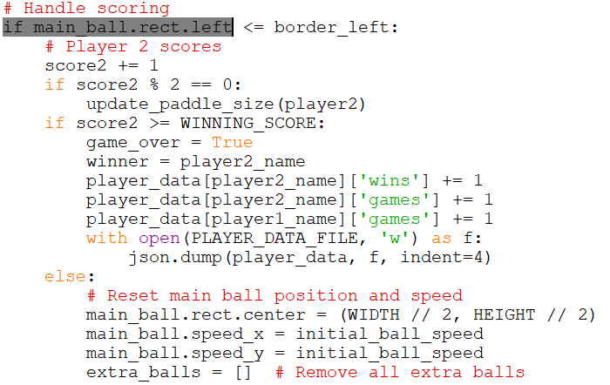
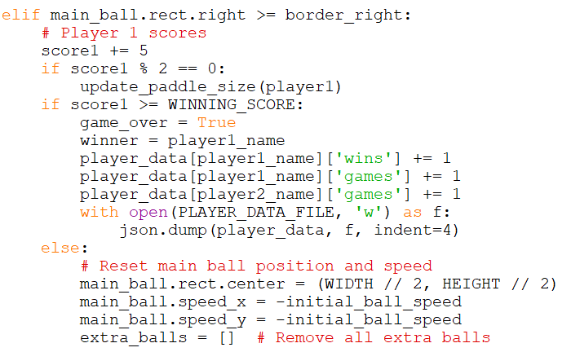
decreasing Paddle Size
Notes:
Hi my name is Jacob Sanchez, I have made an idea in which it’s Pong but the paddles shrink making it a fun challenge or nuisance. It depends on how you see it. I have made ideas and few adjustments to games, like changing the color or head of the snake in the game Snake. That adjustment in coding helped me learn Python enough to make a simple game but I’ll improve on my skills in coding to be better. The next step in my education will be to gain more knowledge in coding.

Slide 12
Double Speed Powerup
Vanessa Mejia

Slide 13
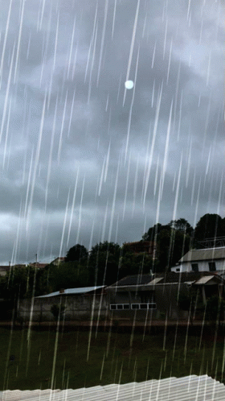
My name is:
Vanessa Mejia
I am a 13 year old who goes to Union Hill Middle School. At this time I will be showing you how long a power up takes and what power-up we will be talking about.

Slide 14
What have I done?:
Well, what I have done was give out a feature for our ping pong game. The feature I gave was doubling the speed of the ball.

Slide 15
What have I learned from python? Well let me tell you:
I have learned the basic things of coding for a game and learned that even 3D games and models use python/coding

Slide 16
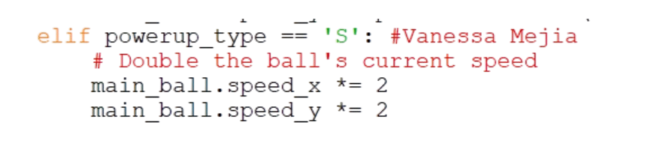
The POWERUP_INTERVAL equals to 5000 which means that the max time of a power-up spawn is either 5 seconds or 5000 milliseconds. For every single power-up, we randomized the interval around 0 and 5 seconds for a power-up spawn in the game.
Well let me show you!
This feature doubles the current speed of the ball. This code is the important part. This part of the code makes the speed of the ball go as twice as fast. As you can see, the x and y axis multiples by 2 for the current speed of the ball.

Slide 17
Redirection Powerup
Dylan Flores

Slide 18
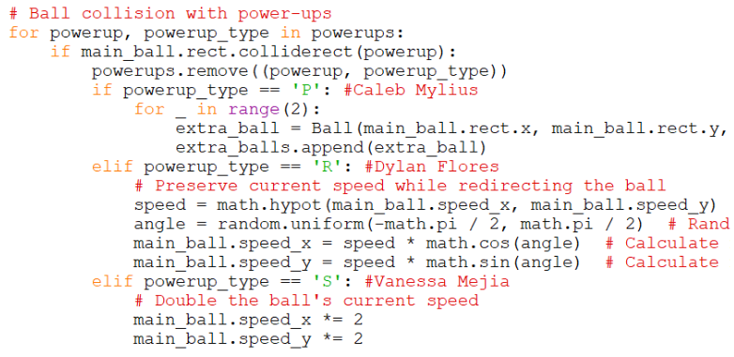
Redirection Powerup
Notes:
Hi, I’m Dylan. For our project, we developed a two-player offline ping pong game using Python. This experience taught me basic coding and its challenges, which I think will be useful in school. I worked on creating an entity that redirects the ball when hit.(shows code) The speed code ensures the ball maintains a consistent speed after impact, addressing issues with the ball becoming too fast or too slow. The angle code uses math to set the ball’s direction, preventing it from bouncing endlessly up and down, which ensures the game remains playable.

Slide 19
Extra Balls Powerup
Caleb Mylius

Slide 20
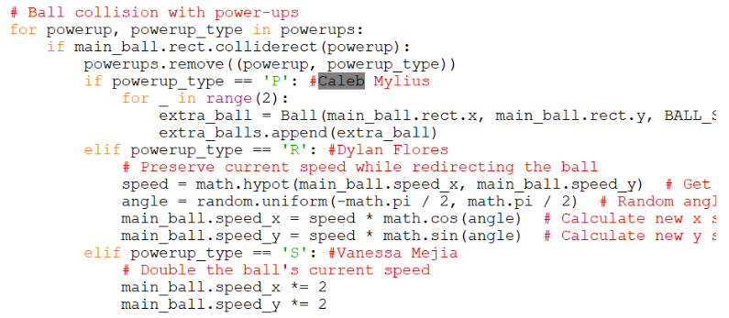
Extra balls Powerup
Notes:
“Hello, I’m Caleb and I will be presenting a feature I added to this pong game. I have requested this feature to be added in the game and although there were bugs at first, we were able to get it sorted out. In this process, I gained a better understanding of how to use Python and the basics. Now, I will show you the feature. [explains what the feature is and its code.] Thank you for listening.”

Slide 21
Original Game play

Slide 22
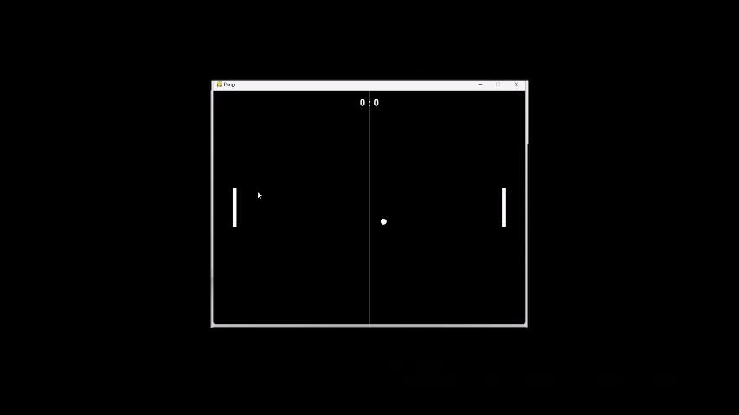

Slide 23
Enhanced Pong
By rwc summer 2024
Intro to python via
Game dev track

Slide 24
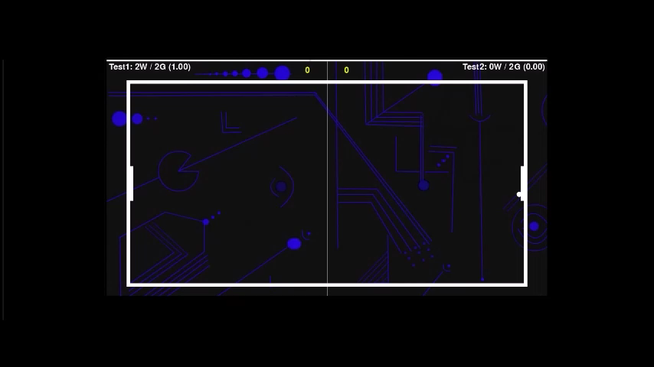

Slide 25
THANK YOU
Coach: Daniel Eric Cynn
Project Developers:
Alejandro Mejia
Jacob Sanchez
Caleb Mylius
Dylan Flores
Vanessa Mejia
Sonja Sosa
Karem Khalifa
Diego Correa

